Slide 1
SVPM College of Commerce Science &
Computer Education
Department Of Bachelor of Business Administration (Computer Application )
A Project Presentation On
Car Rental Management System
Presented by
Mr. Jadhav Rohan Satish (SY BBA(C.A)
Under the Guidance of
Prof. A.A Bhagat

Slide 2
CAR RENTAL MANAGEMENT SYSTEM

Slide 3
Introduction
Car Rental Management System is a software application for automating rental services. It helps customers book cars easily and assists admins in managing records efficiently.
A web based system for a company that rents out cars. This system enables the company to make their services available to the public through the internet and also keep records about their services.

Slide 4
EXISTING SYSTEM
Manual Record-Keeping - Most data is maintained on paper or basic spreadsheets, leading to errors and delays.
Limited Booking Process - Customers need to visit in person or call for reservations, with no real-time availability check.
Inefficient Fleet Tracking - Vehicle usage, maintenance, and availability are not properly monitored.
Payment & Reporting Issues - Lack of automated billing and proper reports for revenue, expenses, and fleet utilization.

Slide 5
Scope
Online Booking & Vehicle Management Customers can easily book cars, and admins can manage fleet details and availability.
Customer & Payment Management - Secure customer registration, booking history, and multiple payment options.
Report Generation & Notifications Automatic reports for admins and alerts/reminders for customers.
Scalability & Multi-Branch Support System can expand to handle more cars, users, and different locations.

Slide 6
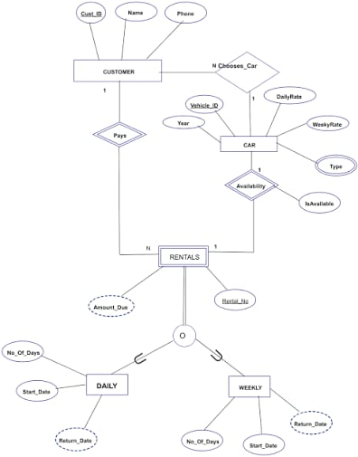
ER DIAGRAM

Slide 7
Software Specifications
Name – Car Rental Management System
Operating System – Windows 10
Language – HTML,PHP
Database – ORACLE
Key Features – Online booking, vehicle inventory management, secure payment integration, customer feedback module, vehicle tracking

Slide 8
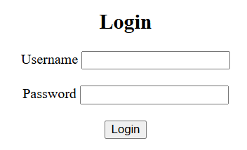
Login Form

Slide 9
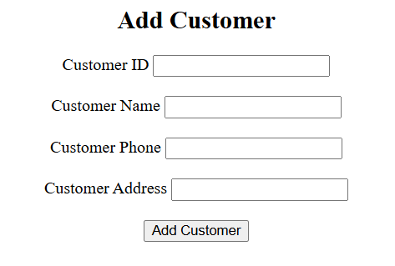
Add Customer Form

Slide 10
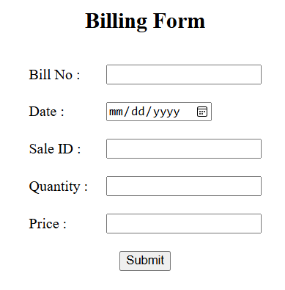
Billing Form

Slide 11
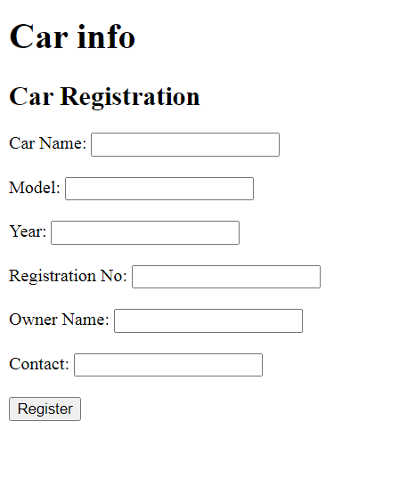
CAR INFO

